Slide 1
XYZ lexer editor
5070379019 吴晔
5070379022 杨嘉晨
5070379025 詹恢洲

Slide 2
Lexer Parser Generator
We use SableCC as parser generator
We use SableCC feature State to parse comment

Slide 3
Token Definition (Helpers 1)
Package xyzlex;
Helpers
all= [ 0 .. 0xffff ] ;
letter = ['a'..'z'] | ['A'..'Z'];
digit = ['0' .. '9'];
sp = ' ' ;
cr = 13 ; // carriage return
lf = 10 ; // line feed

Slide 4
Token Definition (Helpers 2)
tab = 9 ; // tab char
bl = sp | cr | lf | tab ;
new_line = cr | lf ;
underscore = '_' ;
plus_c = '+' ;
minus_c = '-' ;
signed_c = plus_c | minus_c ;
e_c = 'E' | 'e' ;

Slide 5
Token Definition (Tokens 1)
States
normal, comment_new_s,comment_old_s;
Tokens
{normal}if_key = 'if';
{normal}else_key = 'else';
{normal}while_key = 'while';
{normal}int_key = 'int';
{normal}real_key = 'real';
{normal}pre_key = 'pre';
{normal}post_key = 'post';

Slide 6
Token Definition (Tokens 2)
{normal}class_key = 'class';
{normal}extends_key = 'extends';
{normal}public_key = 'public';
{normal}static_key = 'static';
{normal}void_key = 'void';
{normal}main_key = 'main';
{normal} new_key = 'new';
{normal}this_key = 'this';
{normal}boolean_key = 'boolean';
{normal}point = '.' ;

Slide 7
Token Definition
{normal}id = letter (underscore | digit | letter)*;
{normal}real_literal = digit* '.' digit* (e_c signed_c? digit+)?;
{normal}integer_literal = digit+;
{normal}operator = ('&&' | '||' | '>' | '<' | '+' | '-' | '*' | '/' | '=' );
{normal}left_brace = '{' ;
{normal}right_brace = '}' ;
{normal}left_bracket = '[';
{normal}right_bracket = ']';
{normal}left_p = '(' ;
{normal}right_p = ')' ;

Slide 8
Token Definition (Tokens 3)
{normal}semicolon = ';' ;
{normal}colon = ':' ;
{normal}blanks = bl*;
{normal -> comment_new_s}
comment_new_style = '//' ;
{normal -> comment_old_s}
comment_old_style = '/*' ;
{comment_old_s -> normal}
comment_old_style_end = '*/';

Slide 9
Token Definition (Tokens 4)
{comment_new_s -> normal}
comment_new_style_end = new_line;
{comment_new_s}
comment_any_n = [all - [cr + lf ]]*;
{comment_old_s}
comment_any_o = [all - ['*' + '/']]*;
{comment_old_s} star = '*';
{comment_old_s} slash_o = '/';
{comment_new_s} slash_n = '/';

Slide 10
Token Definition (Ignored Tokens)
Ignored Tokens
blanks,
comment_new_style,
comment_old_style,
comment_old_style_end,
comment_new_style_end,
comment_any_n,
comment_any_o ;

Slide 11
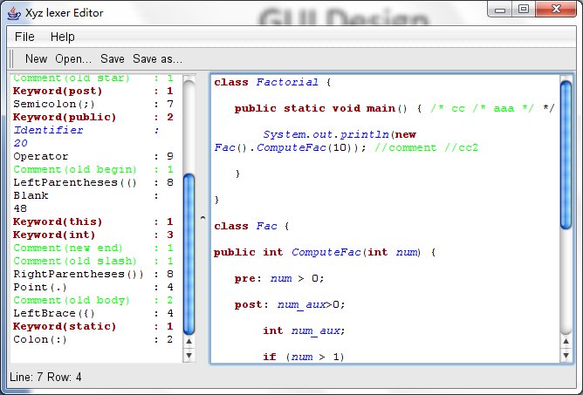
GUI Design

Slide 12
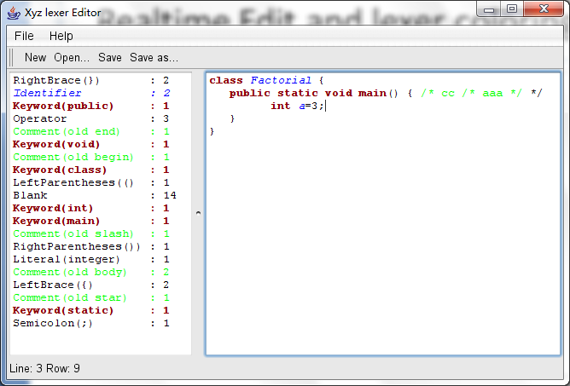
Edit and lexer coloring

Slide 13
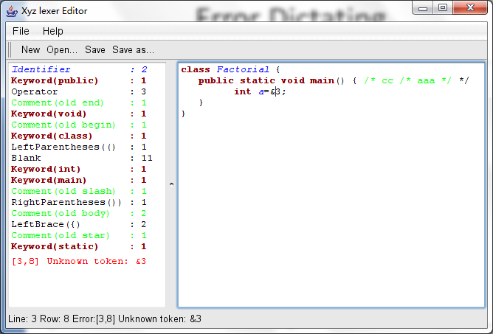
Error Dictating

